Slide 1

Chapter 6 – part I

Slide 2
OUTLINE
  Work.
  Kinetic energy and work-energy theorem.
  Problems.

Slide 3
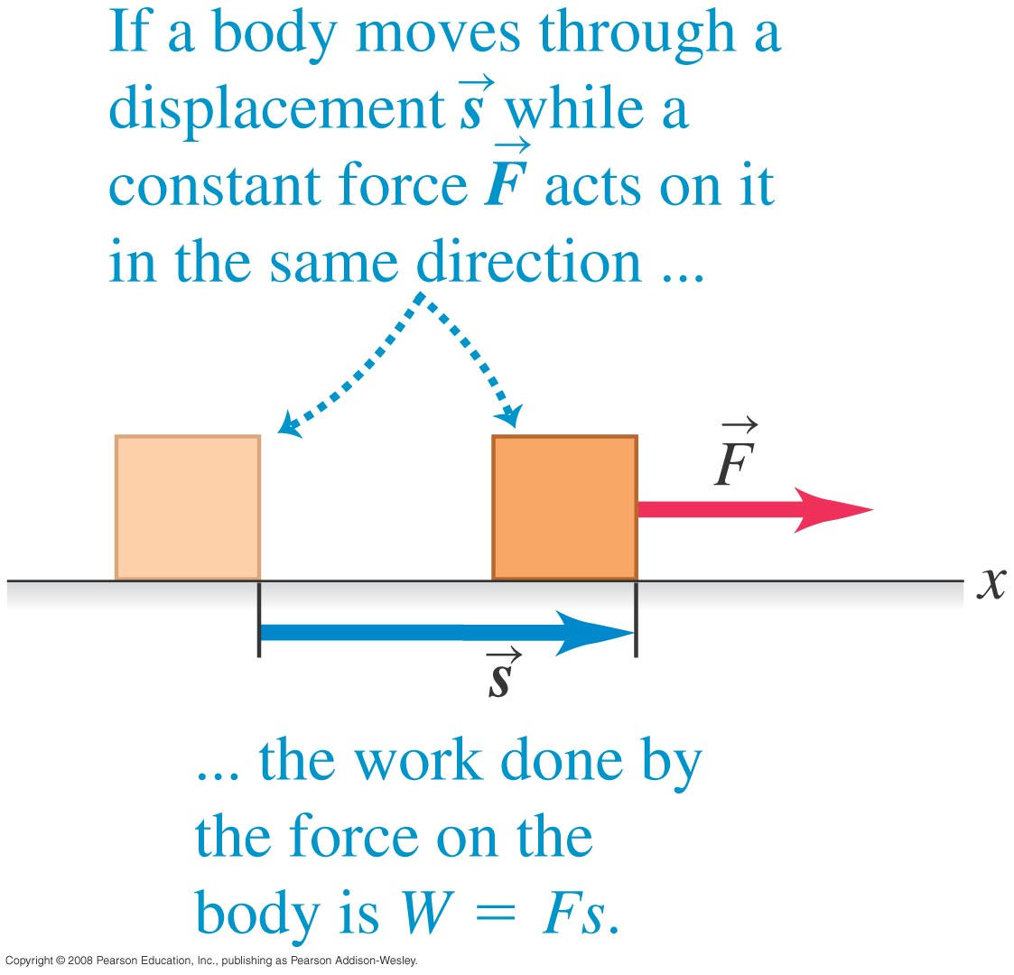
Work
  A force on a body does work if the body undergoes a displacement.

Slide 4
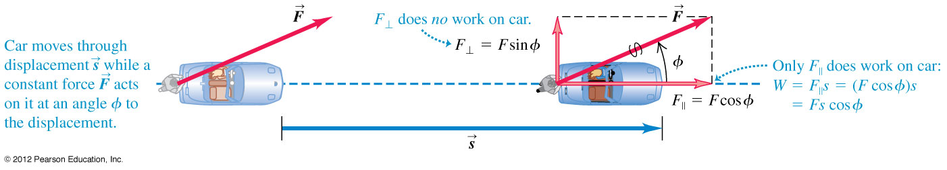
Work done by a constant force
  The work done by a constant force acting at an angle ϕ to the displacement is W = Fs cos ϕ.

Slide 5
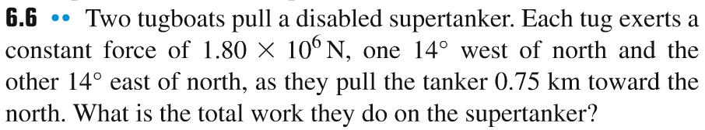
Problem #1

Slide 6
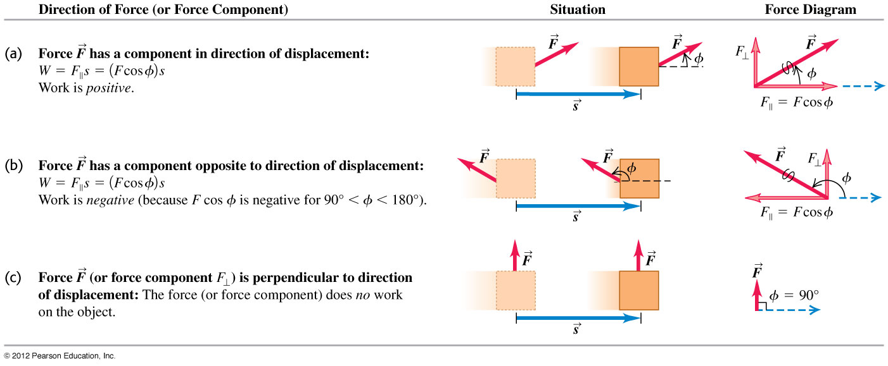
Positive, negative, and zero work
A force can do positive, negative, or zero work depending on the angle between the force and the displacement.

Slide 7
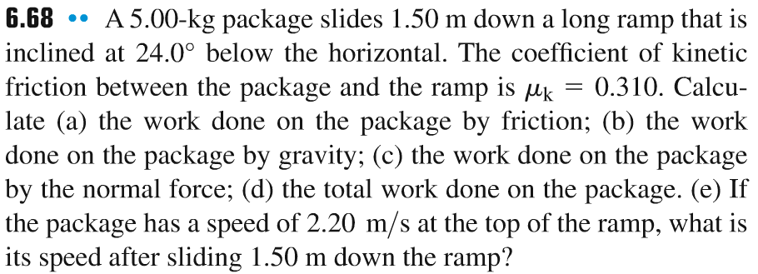
Problem #2

Slide 8
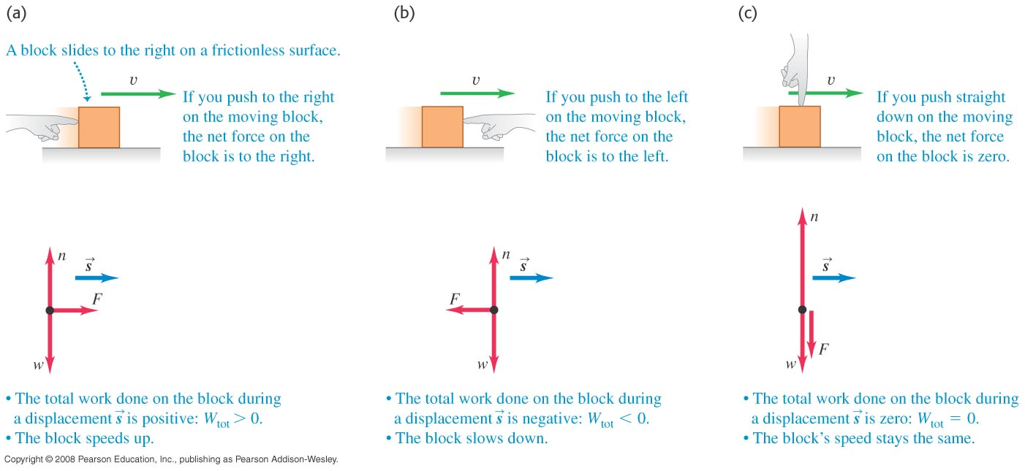
Kinetic energy
The kinetic energy of a particle is K = 1/2 mv².
The net work on a body changes its speed and therefore its kinetic energy.

Slide 9
The work-energy theorem
The work-energy theorem: The work done by the net force on a particle equals the change in the particle’s kinetic energy.
Mathematically, the work-energy theorem is expressed as W_{tot} = K₂ – K₁ = ΔK.

Slide 10
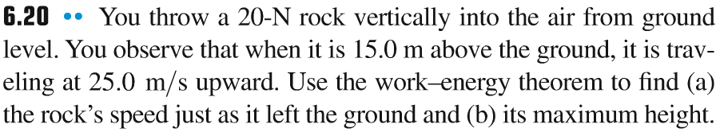
Problem #3

Slide 11
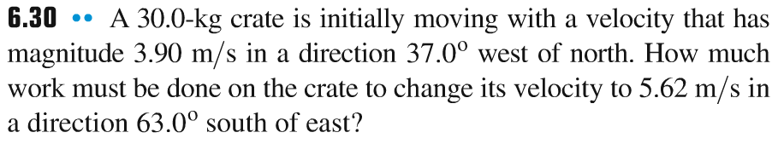
Problem #4

Slide 12
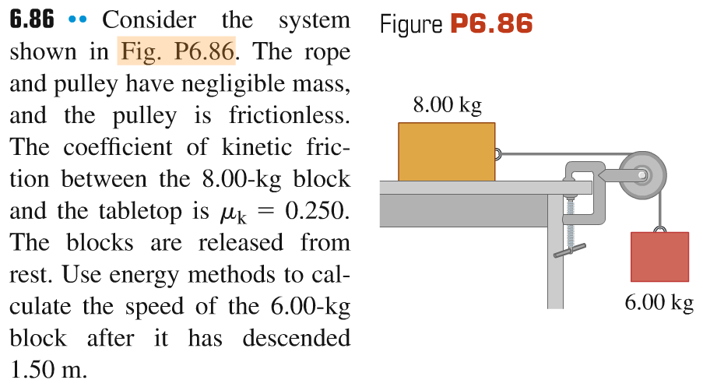
Problem #5

